Slide 1

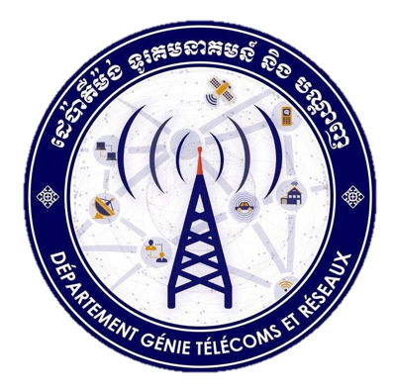
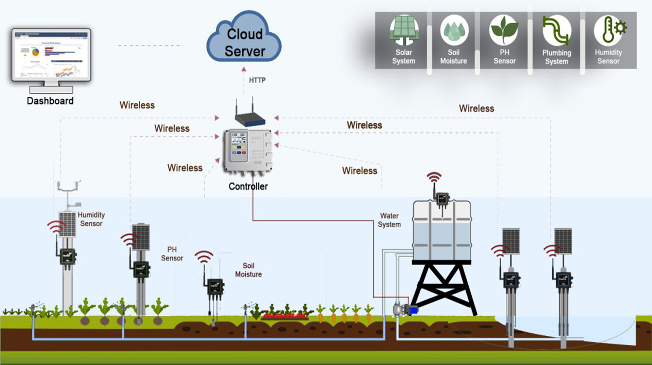

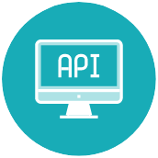
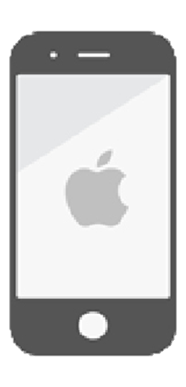
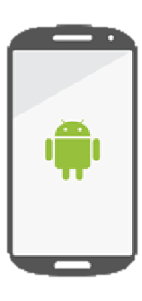
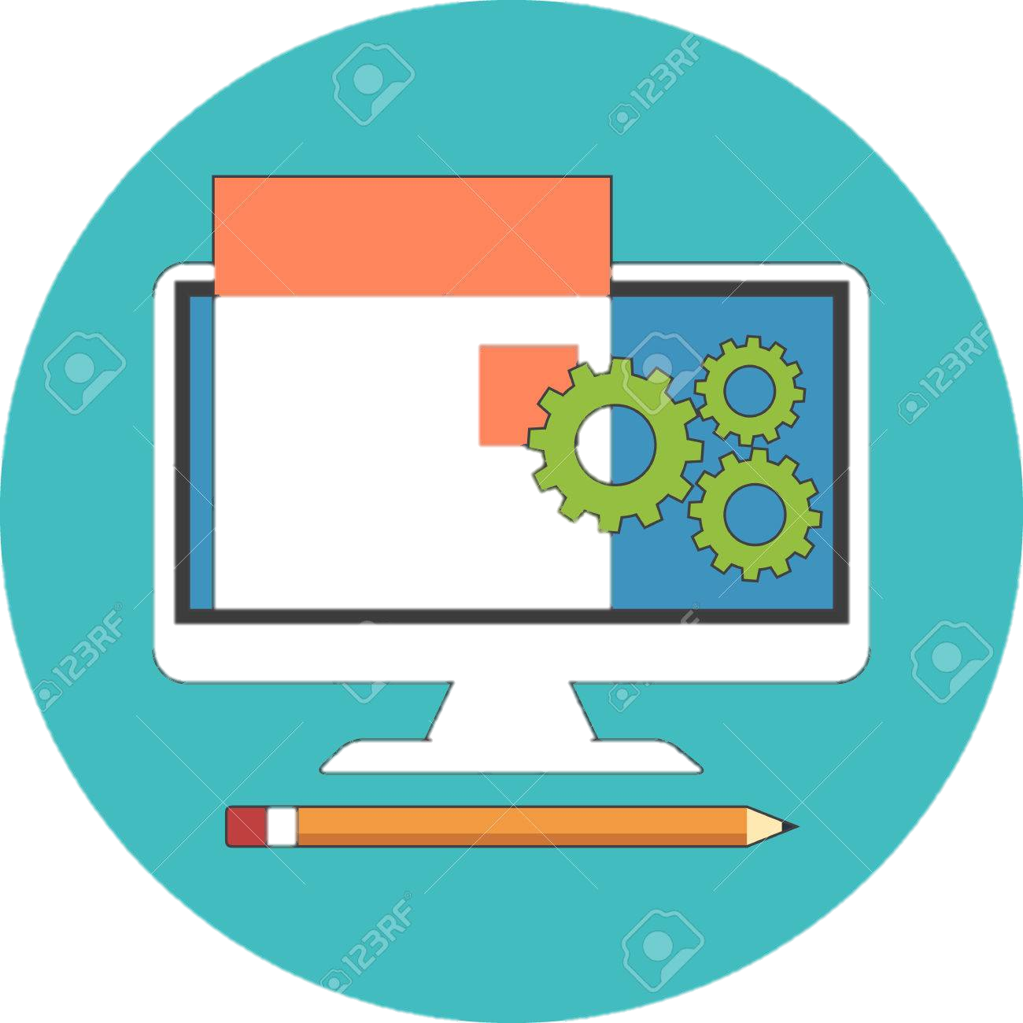
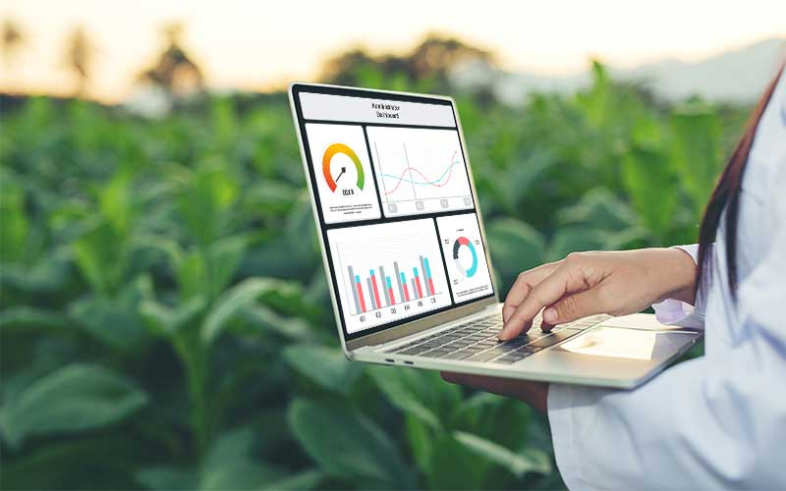
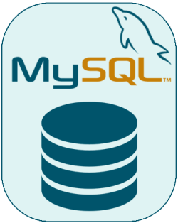
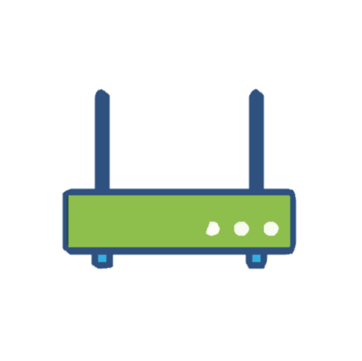
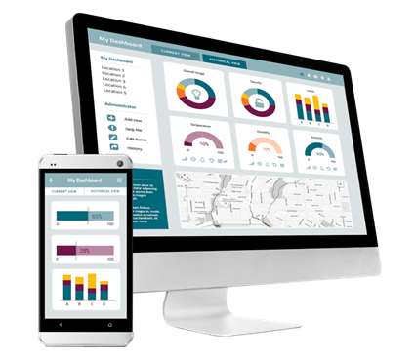
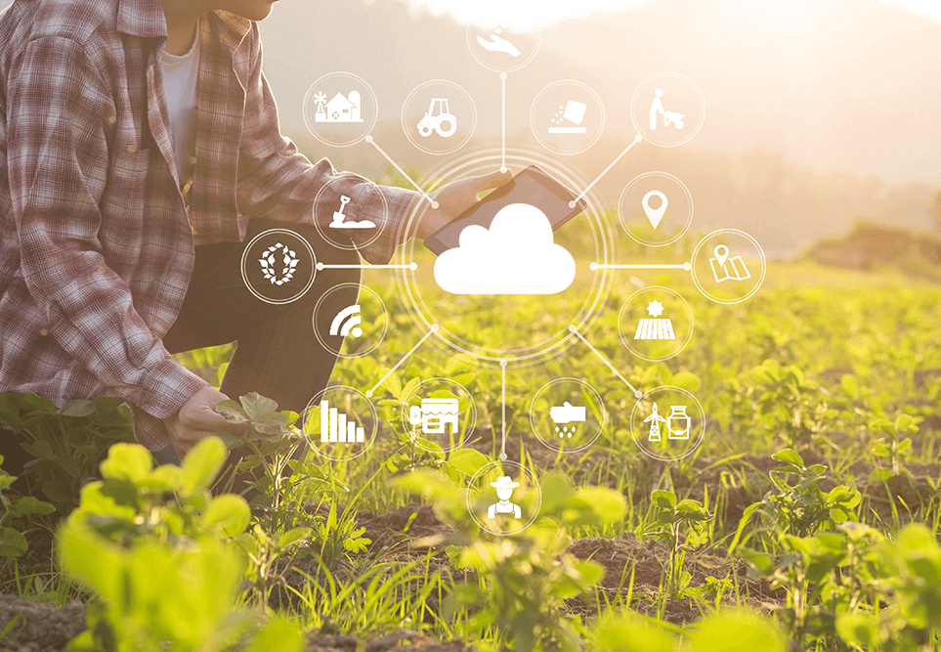
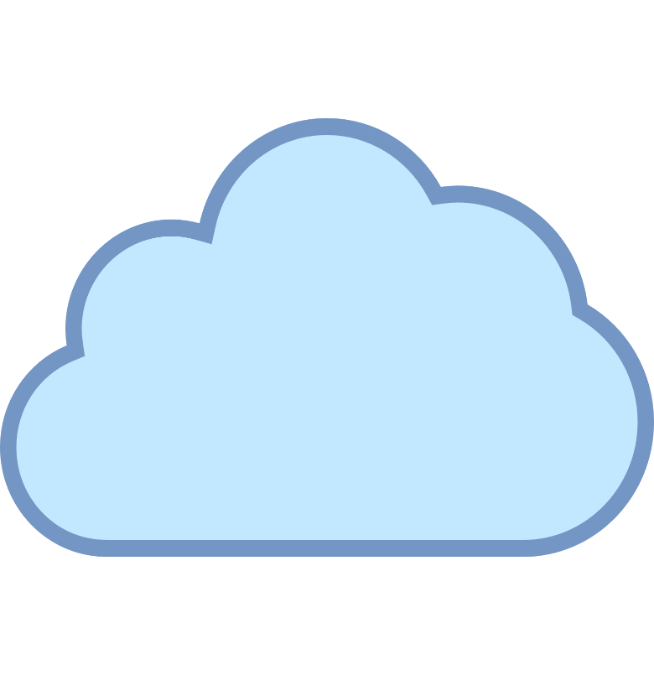
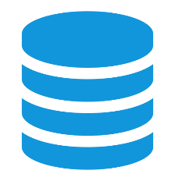
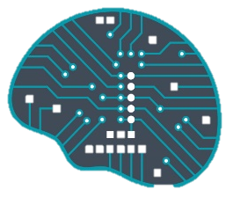
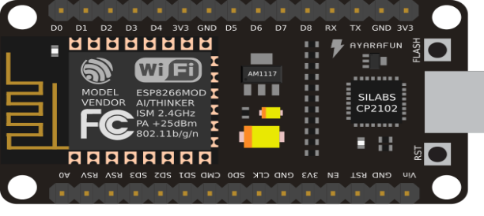
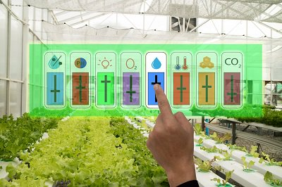
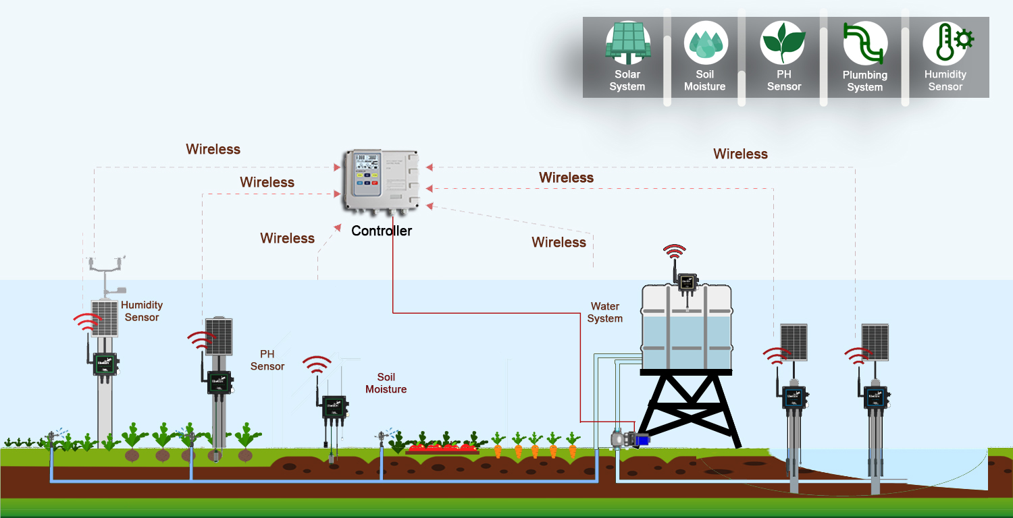


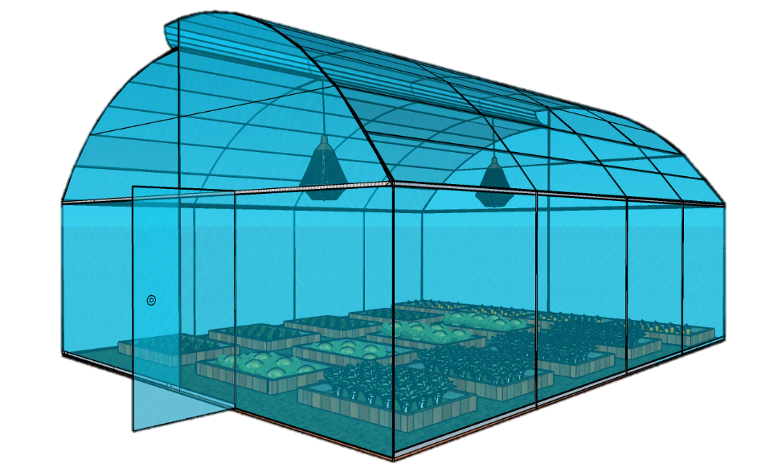
IoT Platform Cloud Storage for Agricultural Application
Advisor : Mr. HEL Chanthan & Mr. CHIN Chandaraly
Student: Mr. VANNAK Sovannroth
INDRODUCTION
SYSTEM ARCHITECTURE
This work aims to develop both the back-end and front-end. Front-end will be developed to monitor the data of each project/farm through web application that is compatible on both mobile and computer and plot the information from the database. The Backend will be developed for communication to front-end, data collections, and manages the data in the database that it also allows users to access information from the server.
The research focuses on IoT platform cloud storage for agricultural application. Web/mobile application will be developed that it is an IoT analytics platform service that allows us to aggregate, visualize and analyze live data streams in the cloud, it provides instant visualizations of data posted by devices. It will view data value of temperature, soil moisture, humidity, pH, and solar radiation on dashboard as charts and it will view videos record of plant growth from webcam in greenhouse on frontend and backend (web/mobile application).
Backend
Front-end
OBJECTIVES
Developer
iOS
Android
The farmers will be able maintain, monitor, and control real-time environment information of the smart farm via mobile/web application remotely or can be locally either. This will ensure an environment conducive to the growth of plants at any time, from anywhere, through the Internet.
REST API
Web Application
Fig. 4. System Architecture of Smart Irrigation
Sensor Node
IoT platform cloud storage is a part of smart irrigation project, it will be designed for managing data of projects, user, device information and data collected from Sensor Node in the farm. All data are stored in database and will be monitored and managed on the front-end.
Database
REST API
Gateway
Fig. 7. Architecture of IoT Cloud Storage
Fig. 1. Farmer views data on dashboard
Web application will be developed by using Laravel 7 framework (using PHP language) with Bootstrap 4, and to develop a web application, the code is written in HTML, CSS, and JS. The main goal in the web application is to communicate with the server, be able to send and collect data from database.
Mobile application will be developed by using Flutter framework with Dart language that it will be able to develop both iOS and Android.
REST API is used for communication between web application, mobile application, database, and Sensor Node.
Famers will able use IoT devices to measure temperature, humidity, moisture, webcam, and water pH values in the greenhouse. Those captured environmental parameters can be displayed on mobile/web application through the internet cloud service.
Fig. 5. IoT Cloud Storage
Web/Mobile Application
Cloud & Server
Microcontroller
Fig. 2. Smart Phone IoT device
Farmers will able to manually or automatically control the watering pump, and/or airflow fan to create suitable environment for growing the plants in the greenhouse. The real-time environmental parameters are able to be displayed and controlled off-line or on-line.
Database
AI
APPLIICATIONS
This project is intended to develop a smart irrigation for smart farm by deploying IoT technology. Using this system, a farmer can share/access the innovative techniques used by him/other farmers to improve the yield, can get the details about irrigation based on moisture control and temperature, crop maintaining information, pesticide details for his farm. Through this framework a farmer can get latest updates via smart-phone/web application.
Webcam
Fig. 3. Remote Control Sensors
Farmers
Fig. 6. The Proposed Smart Farm
ITC Greenhouse

